Slide 1


Slide 2



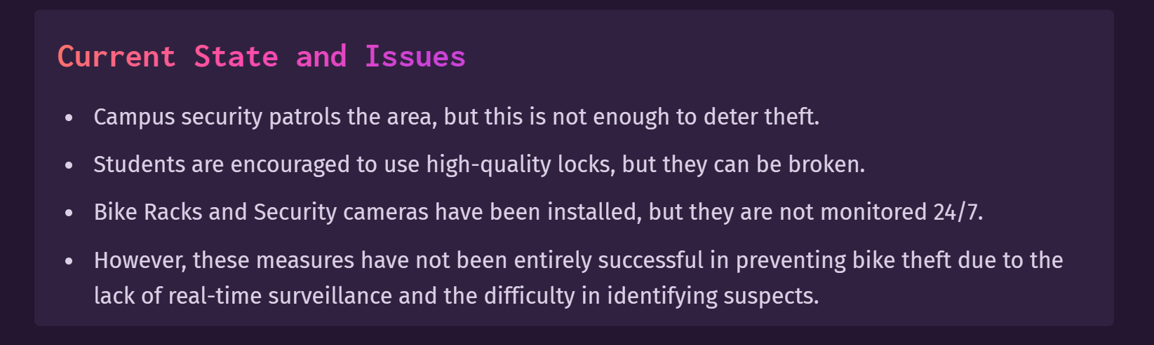

Slide 3





Slide 4
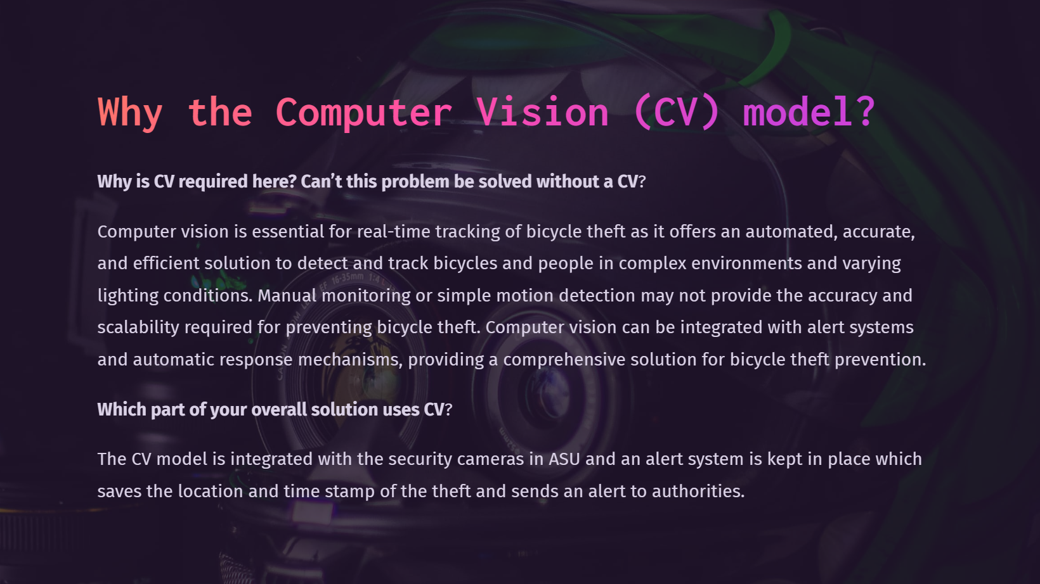

Slide 5
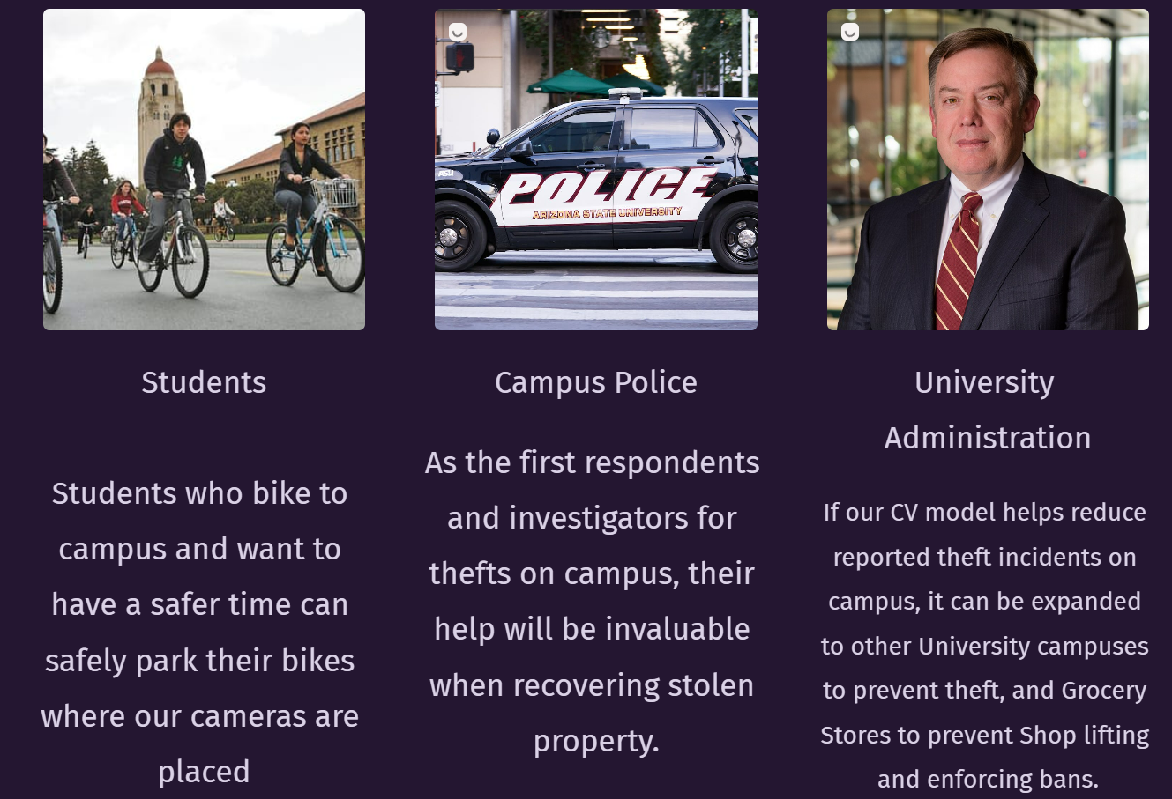

Slide 6
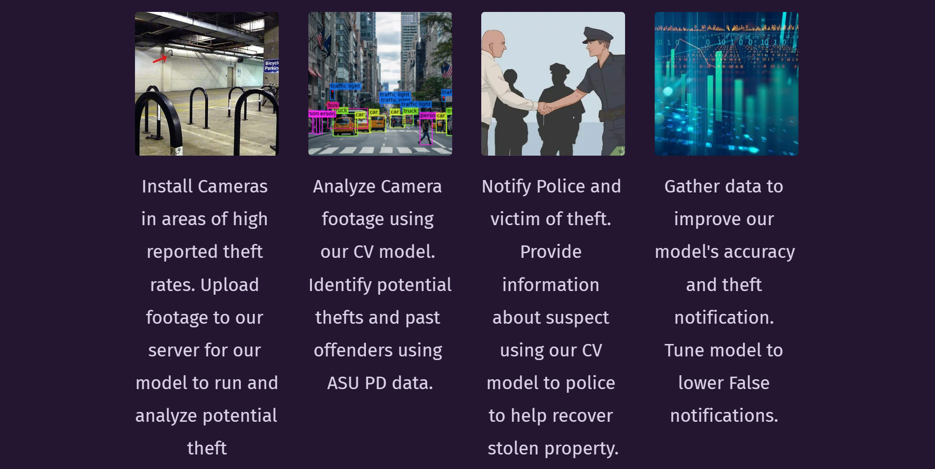

Slide 7
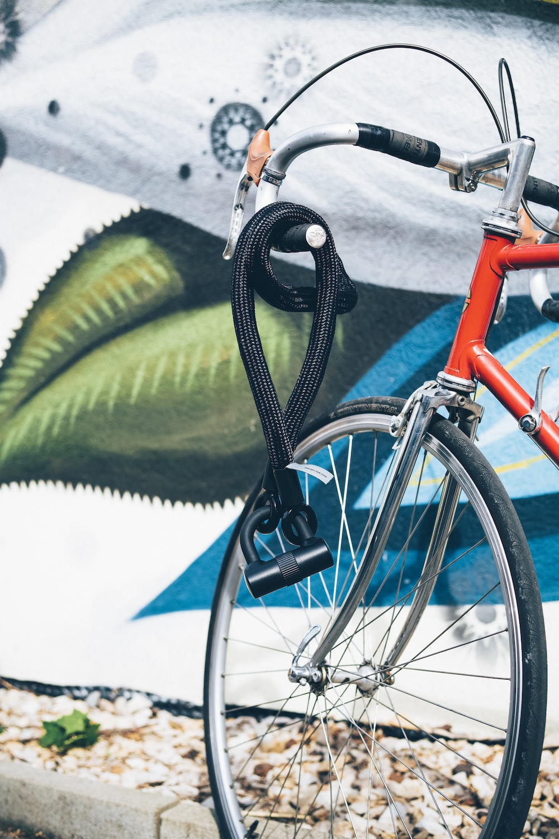
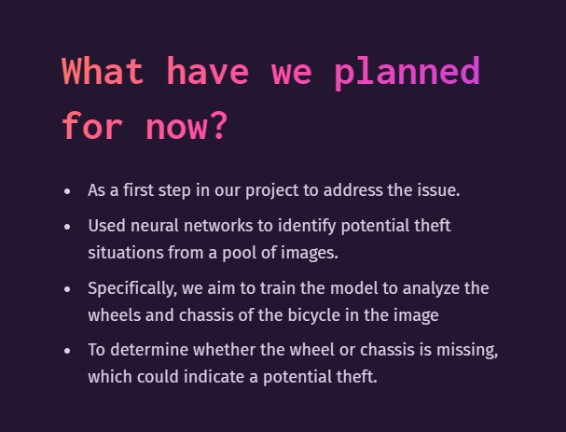

Slide 8


Slide 9




Slide 10
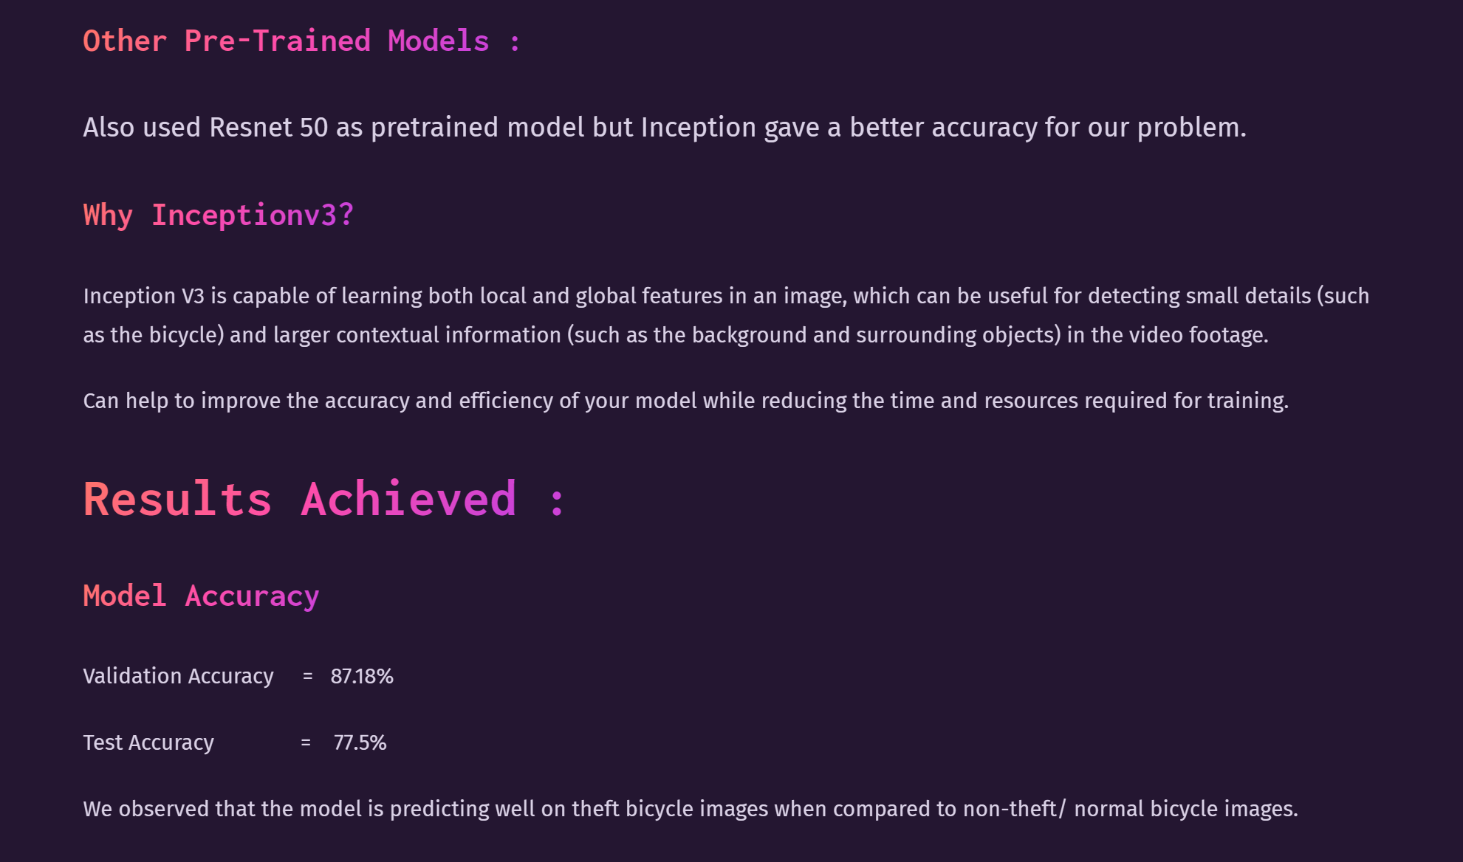
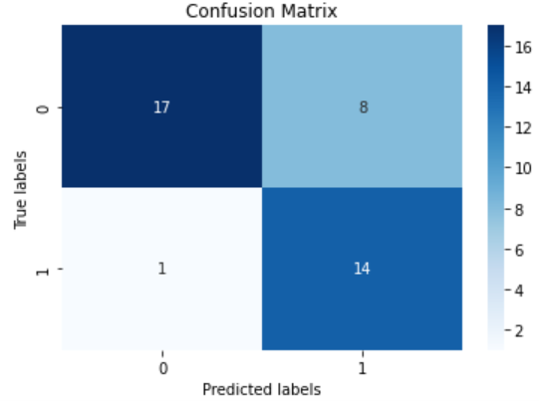

Slide 11


Slide 12


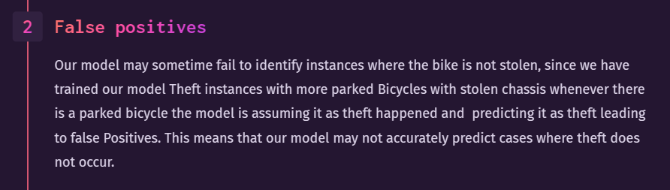
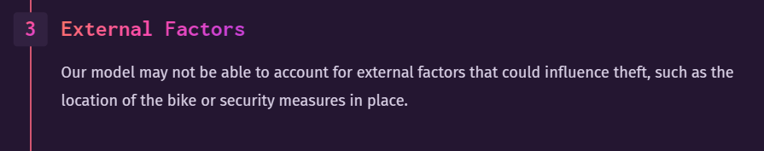


Slide 13


"In Fall 2022 State Press recorded 118 incidents of bike theft were reported to the ASU Police Department“
By running our CV model, we hope to reduce reported theft incidents by installing our model in areas of high reported theft.
Currently less than 50% of bicycles that are reported stolen are recovered by their original owners.
By providing ASU PD with an image of the suspect and the time of theft, we can aid in the recovery process.
Improved Response time from campus security when theft is reported in locations using our CV model.
One of the biggest problems faced when your bike is stolen is the delayed response in reporting the theft. Our model solves these two critical concerns.

Slide 14


Slide 15


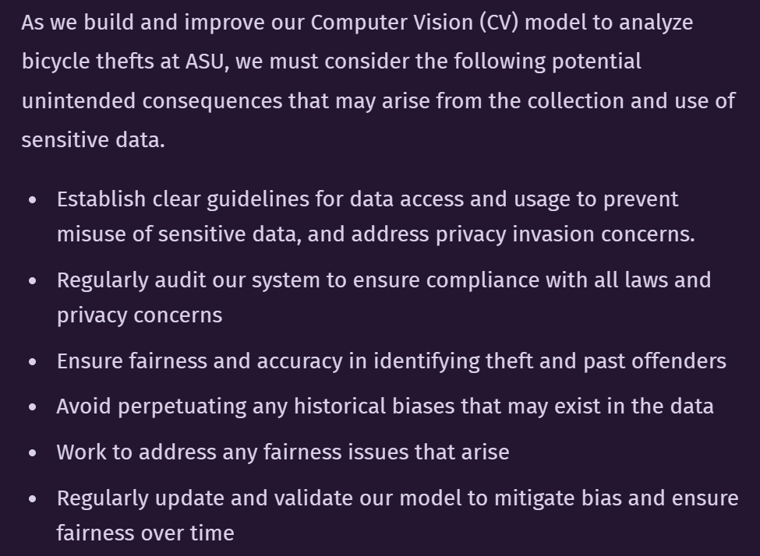

Slide 16

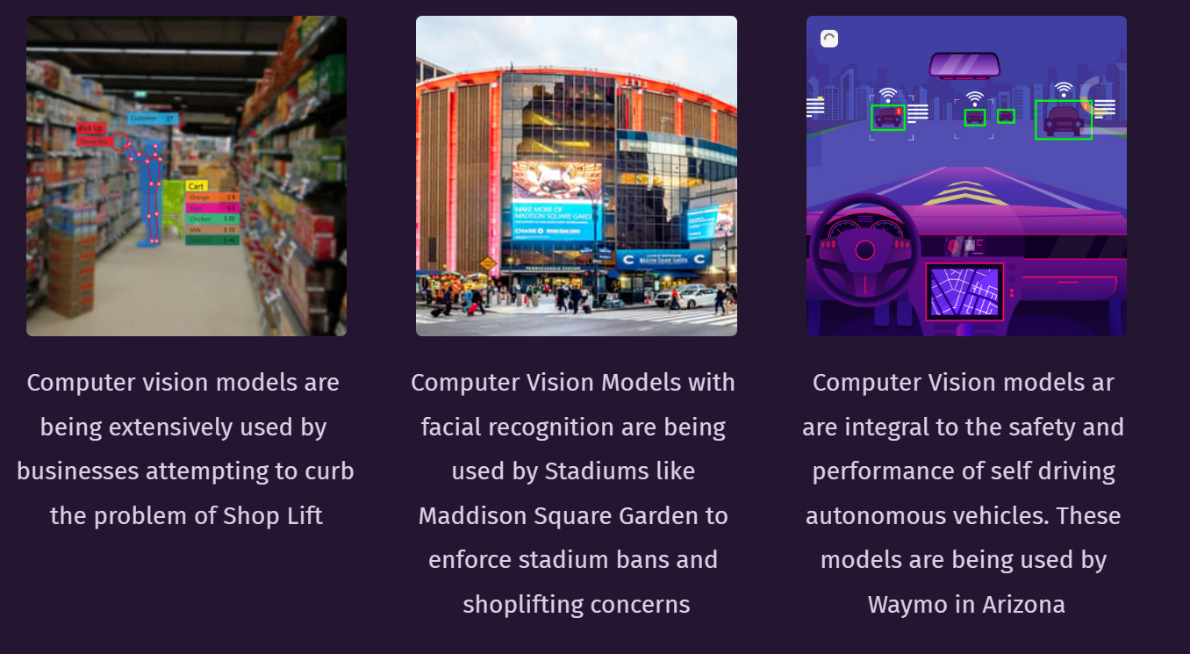

Slide 17


Slide 18



Slide 19
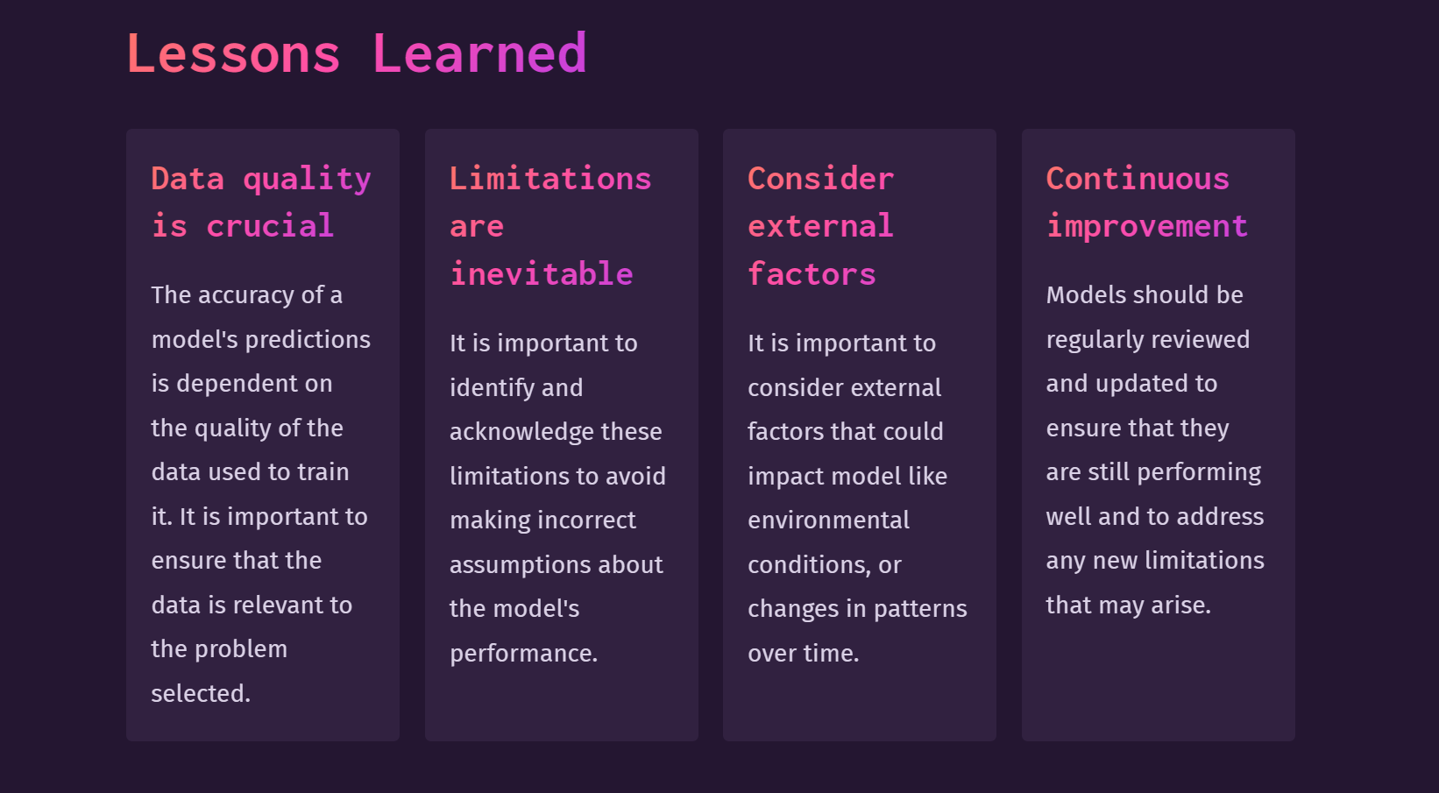

Slide 20

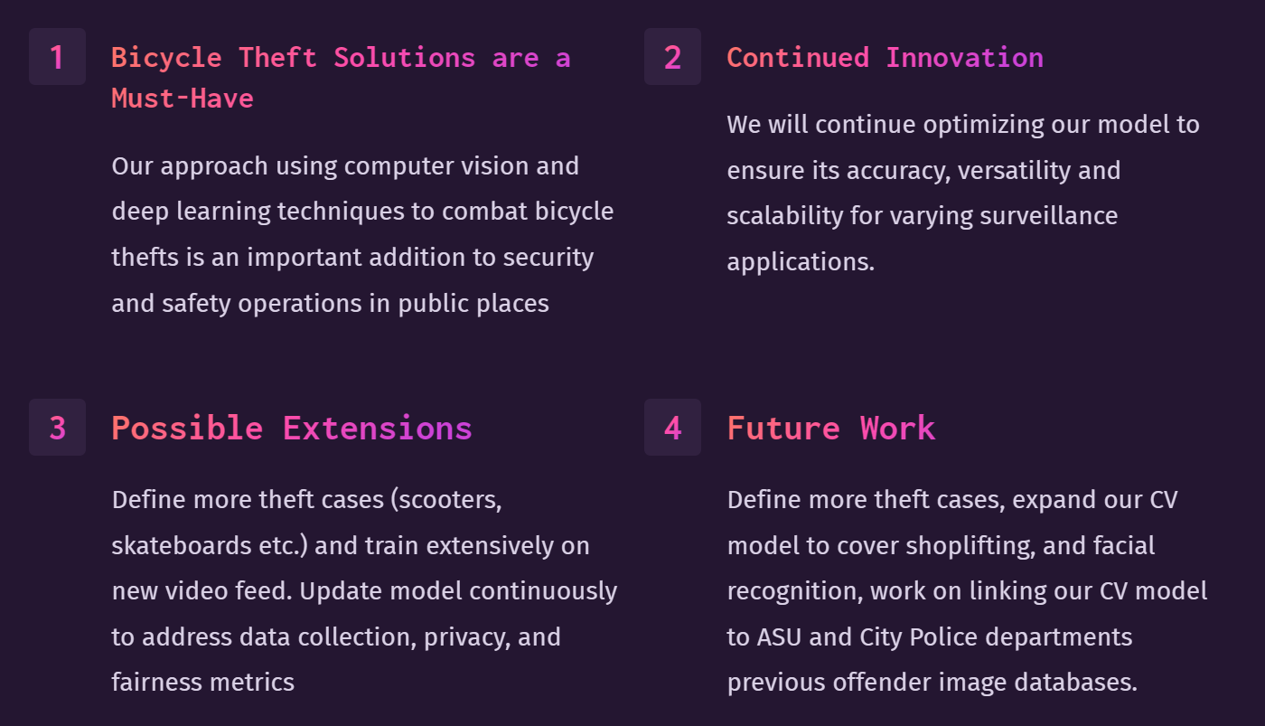

Slide 21


Slide 22


Slide 23

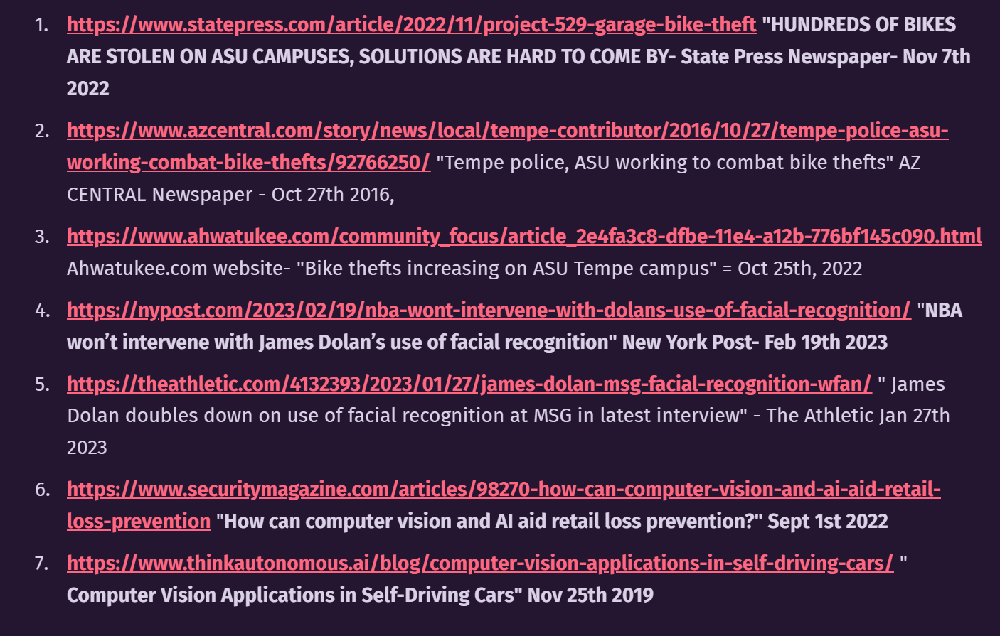

Slide 24


Slide 25


